Slide 1


Sale Price Forecasting
Geoff Counihan - July 11, 2017
Notes:
Introduction:
Hello, my name is Geoff Counihan and this is my capstone project for the Data Science Bootcamp - Sale Price Forecasting
Keep focused on just T+3 results, then say did that for T+2 and T+1 also
Come off with value as opposed to process
Not I think and I found
This exists and this is how I took advantage of it
Practice reading from the laptop as if it were a teleprompter
Can i weave any transitional phrases into my pres?
‘You might be asking’
3 things learned
Buy low sel high, feb to july
Be explicit about the target variable and what your predicting.
Don’t get into grid searching, just mention that it was the best model for all cities
Say your name strongly
Finishing sentances fully
Add more interesting ideas found throughout
What is the key phrasing to say what and how the residual

Slide 2
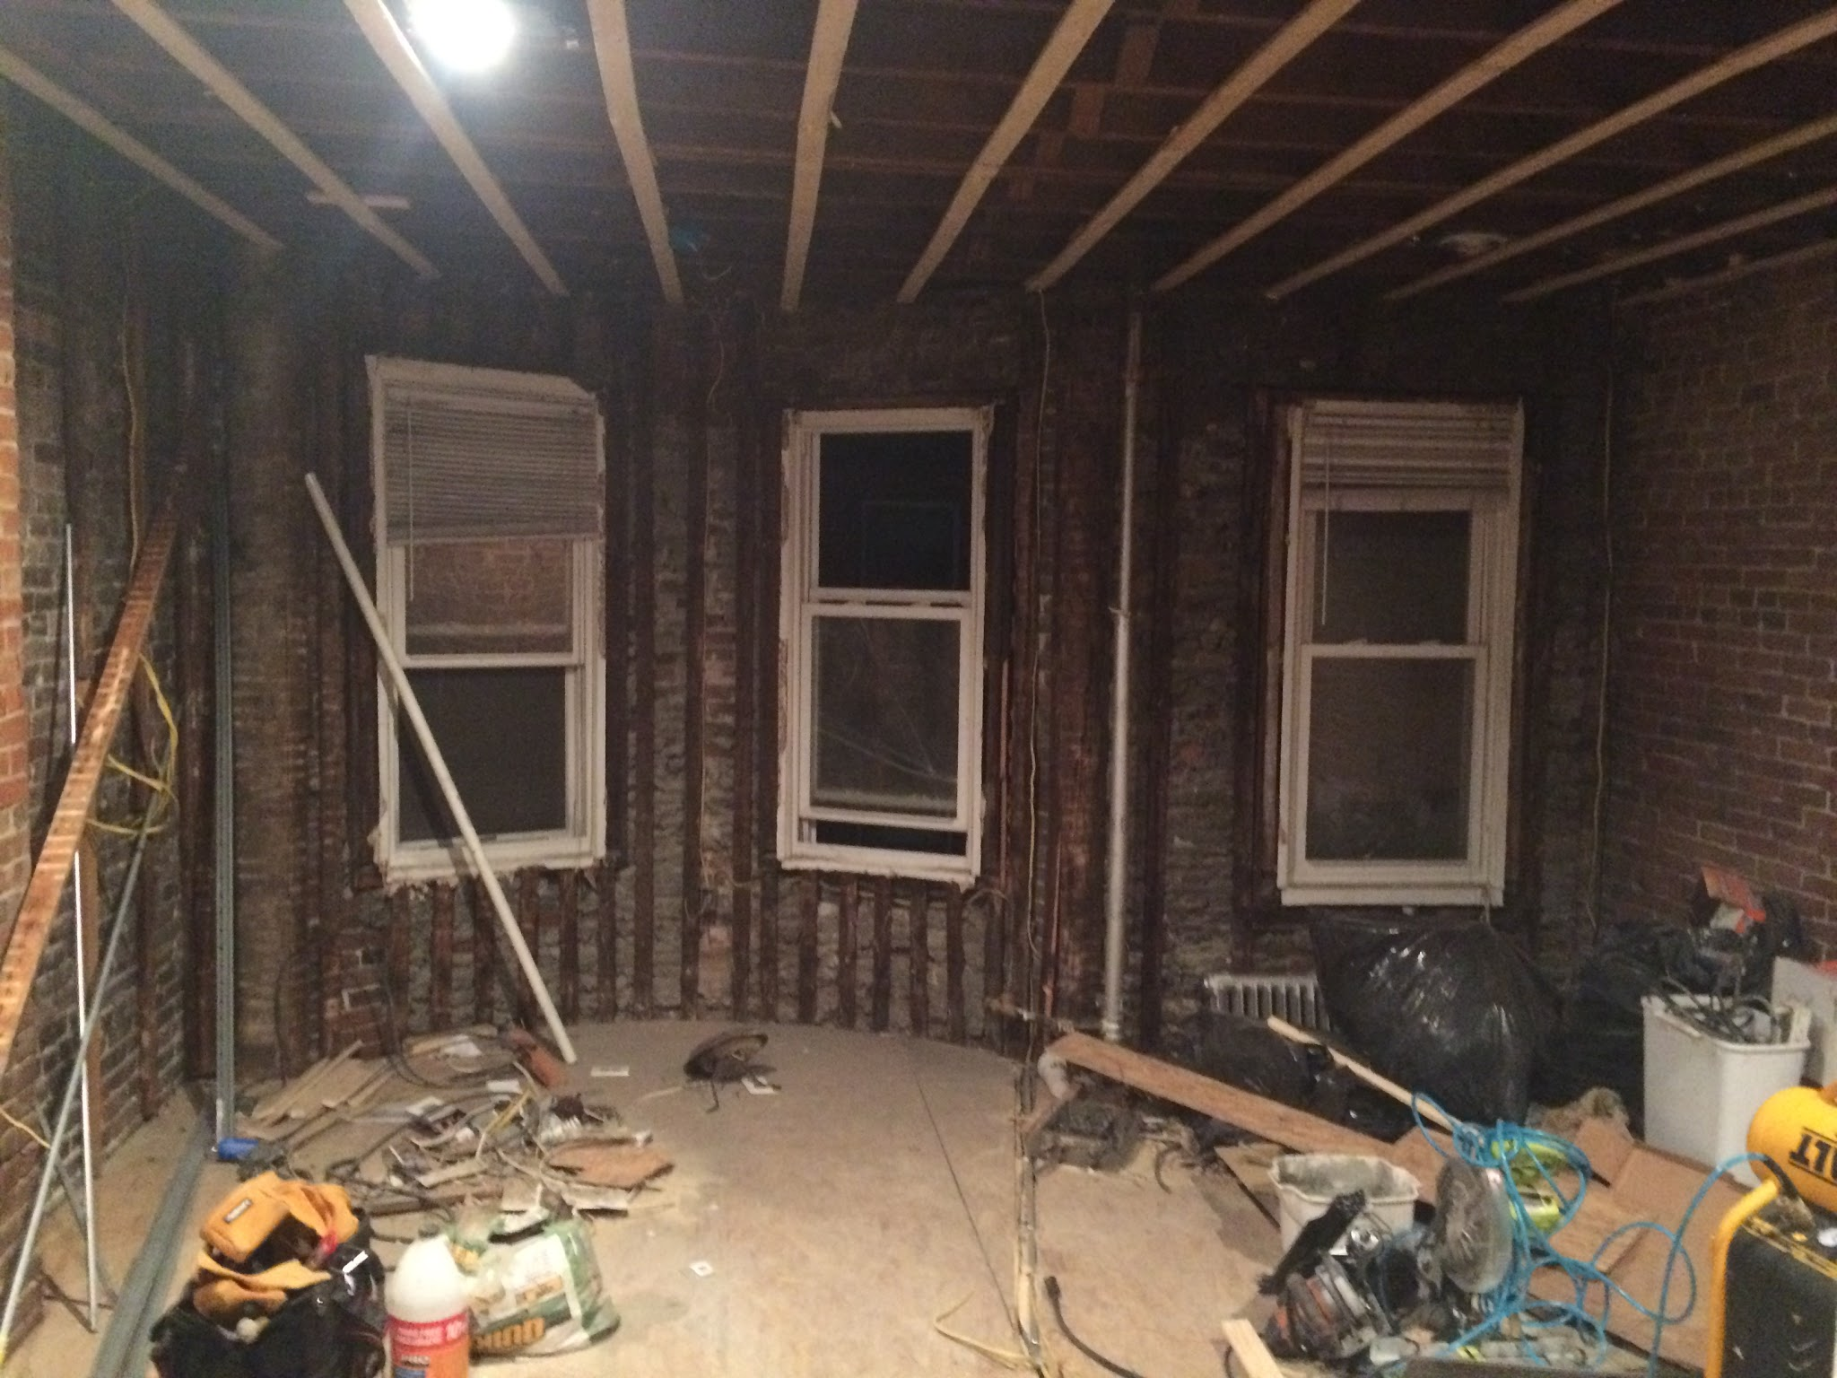

The Inspiration
Notes:
I became fascinated with real estate after I purchased and renovated a condo ~3yrs ago.
So, I was curious of what datasets were available for housing markets and what useful insights could come from them.
For a previous project, we analysed a housing data to predict sale price in Ames Iowa. Each sample was a particular house and the features were characteristics such as sqft, # of bedrooms, lot size, etc.

Slide 3


Redfin Data Center
Monthly macro statistics of home sales
Every major market in the US
27 metros: Boston, San Jose, LA, Portland, Seattle, etc.
Extends back 8.5 years
Statistics:
Median Sale Price, Median List Price, Median DOM (Days on Market), Median Ppsf, Inventory, New Listings, Avg Sale to List, Homes Sold, Months of Supply, Price Drops, Sold Above List
Example:
For all types of property in Boston sold in June 2016, the Median Sale Price was $395k
redfin.com/blog/data-center
Notes:
Explanation:
So I looked for a broader dataset and found Redfin’s Data Center.
It is a Timeseries dataset, with macro level stats across nearly all metro regions in the US
Naturally, Median Sale Price was the target I wanted to predict.
And since the typical sale cycle for a home is ~2-3 months, my goal was to predict it 3 months out.
In doing so, I would be able to inform house flippers or average joes when to begin their search for a home.

Slide 4

Key takeaways
Take advantage of the seasonal trends
Vary greatly city to city
Boston: $60k swing, ~15% delta in price between Feb and June
Use trailing 3, 5 and 10 month features
Across all cities
Explain an additional $6k, unaccounted for by seasonality
Notes:
Before I dive in, I want to give you a broad overview of the most important findings:
Seasonal trends are your friend:
It is well known that the real estate market is seasonal. But interestingly, seasonal trends between cities vary so greatly that the best indicator of when to buy/sell is to examine the historic trend of your city.
So, If you have the freedom to purchase and sell any time of the year: buy in the winter sell in the summer.
Over the seasonal trend:
The trailing 3 month Median List Price
The trailing 5 and 10 month Median Sale Price

Slide 5
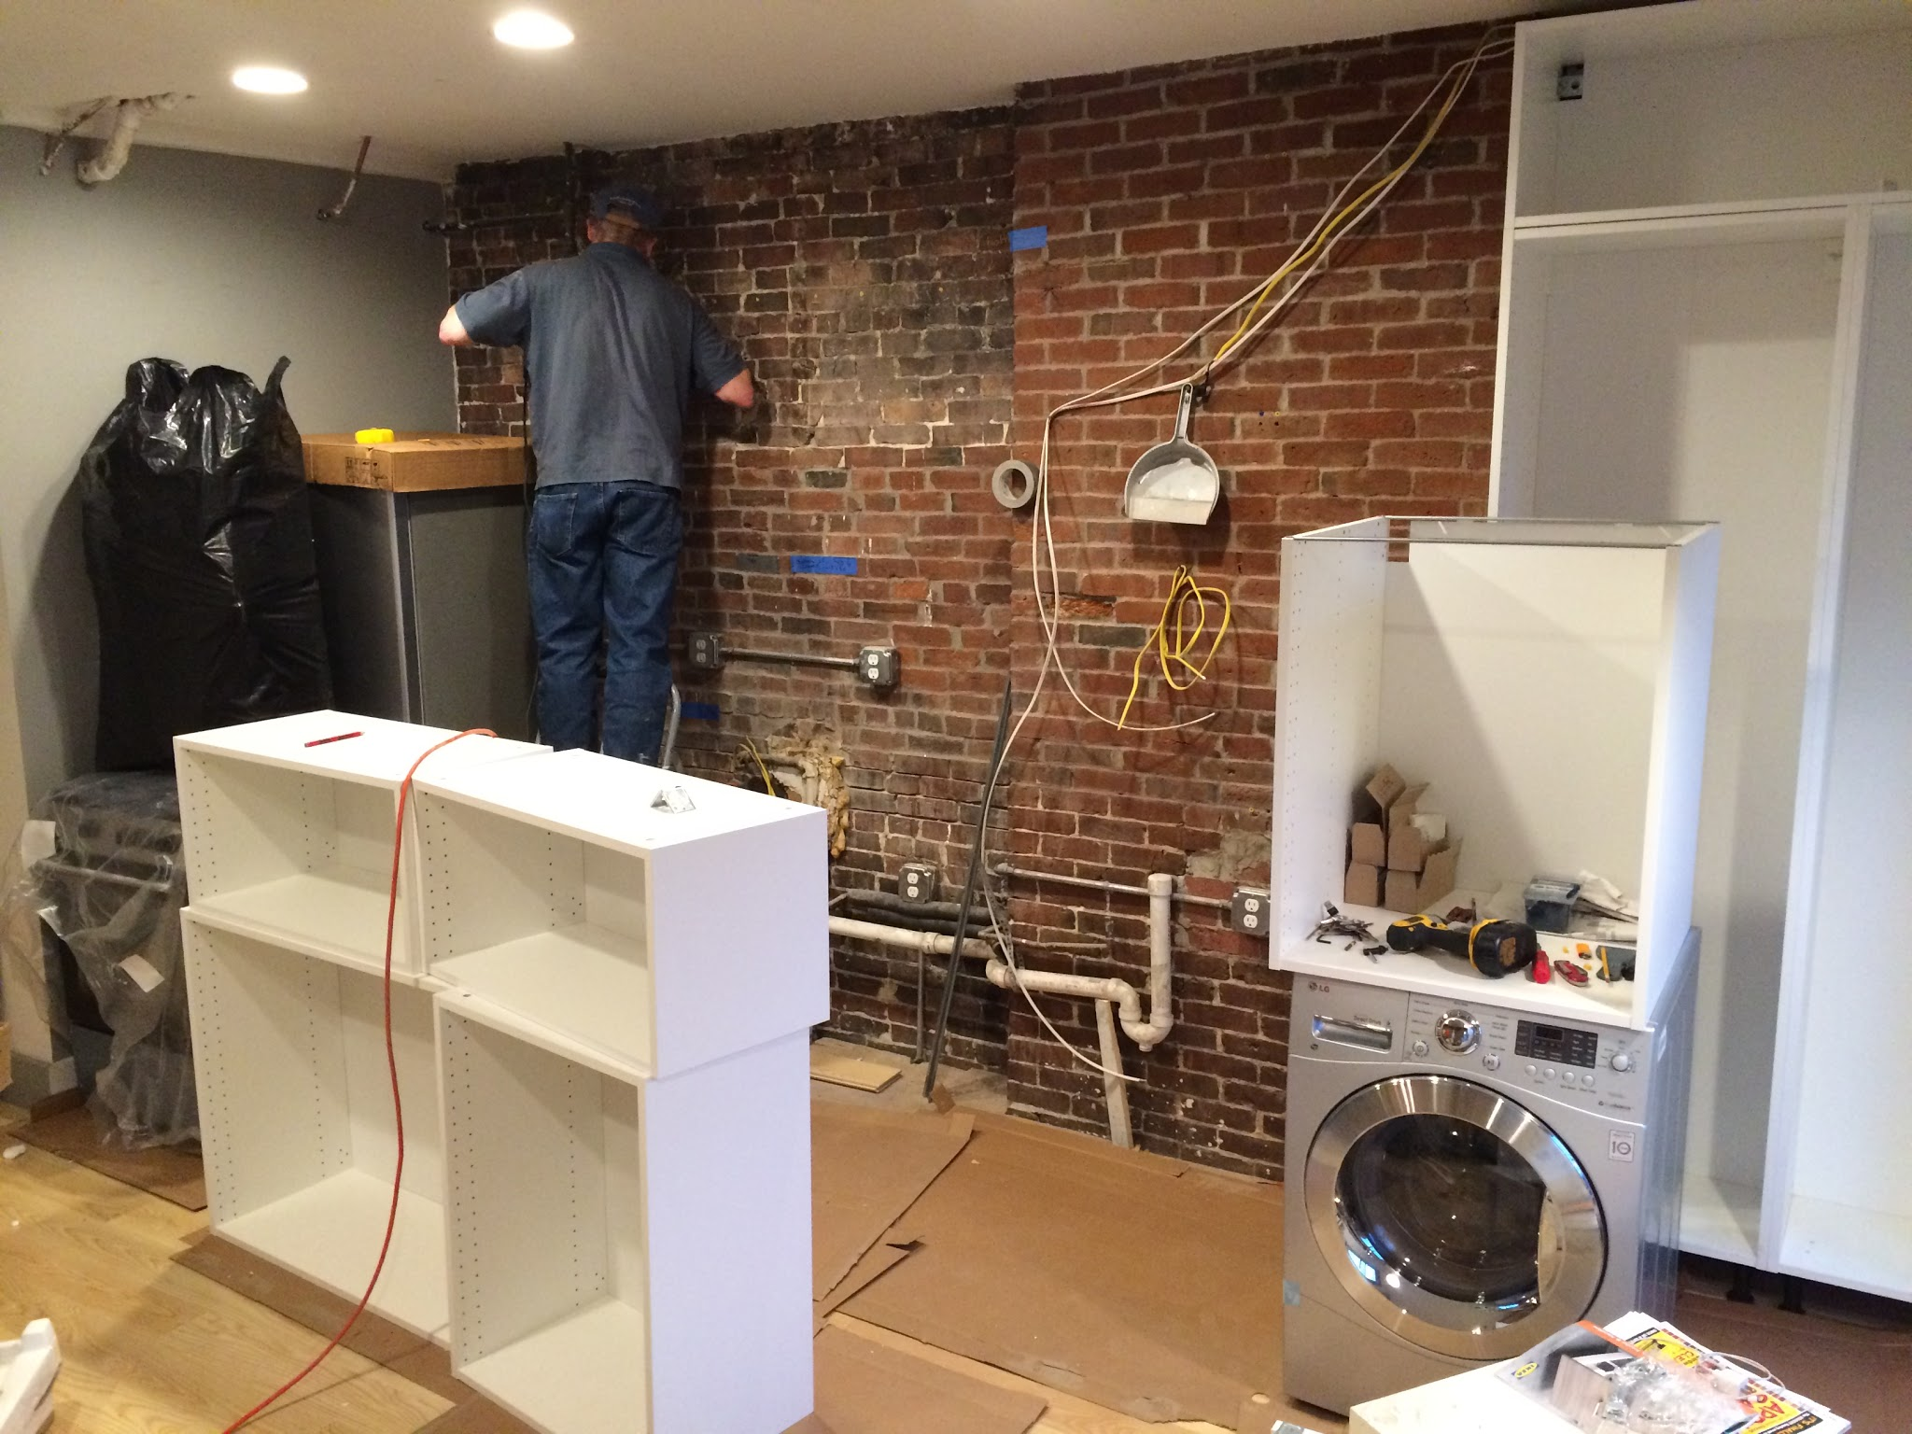
Why is this useful?
Imagine you’re a small time, residential, house flipper
Small volumes of 8-10 flips a year
$10.2k saved per transaction balloons to $204k profit per year
Without taking advantage of seasonality
Only profiting off the additional value add from your renovations
It's hard work!
Notes:
Talk:
Imagine you’re a small time, residential, house flipper.
Being able to forecast your capital allocation improves your business.
Saving a little bit of money per transaction goes a long way
Without taking advantage of seasonality, you’re only profiting off the additional value add of your renovations, so why not take advantage of the seasonal trend if you can?

Slide 6
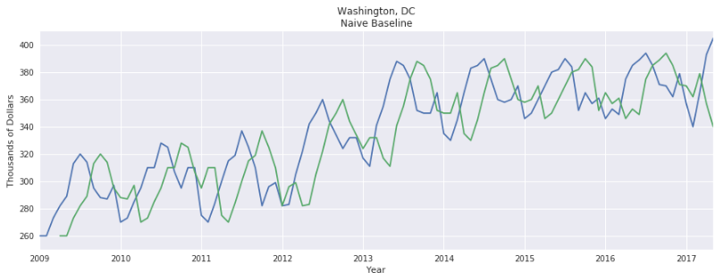
What is a Baseline Model?
Naive Baseline
Use current value to predict future value (3 months ahead)
Notes:
Explanation:
In Machine learning we always like to spot check our models to a baseline model. Typically that means the simplest model you can think of.
In Timeseries forecasting that is the naive baseline or persistence model. It works by using the current value as the prediction for the future value. Though it seems silly, since timeseries are non-stationary, the value most similar to the next value is usually the one right now.
Clearly using the current value to predict the Median Sale Price 3 months ahead leaves a lot of room for improvement. But it is a good benchmark.

Slide 7
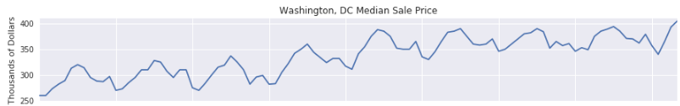
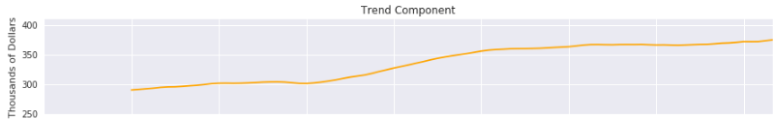
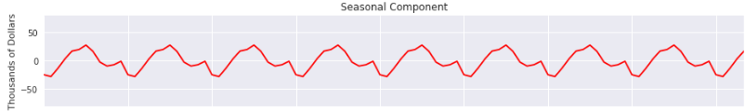
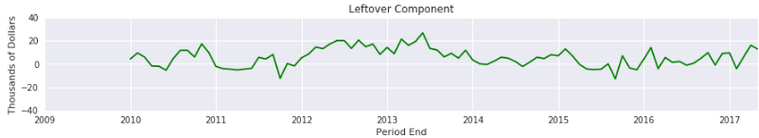
Using Seasonal Decomposition
Break the target into 3 parts:
Trend (12mo moving avg)
Seasonality (12mo periodic)
Leftover (unexplained)
All three added together creates exactly the same target as original
Notes:
Explanation:
Another simple technique would be to use Seasonal Decomposition. What is it?
It breaks down the target into 3 components:
Trend (12 month moving average)
Seasonality (12 month repeating signal)
Leftover component (unexplained by the trend and seasonality)
All three of these components added together equal the original target

Slide 8
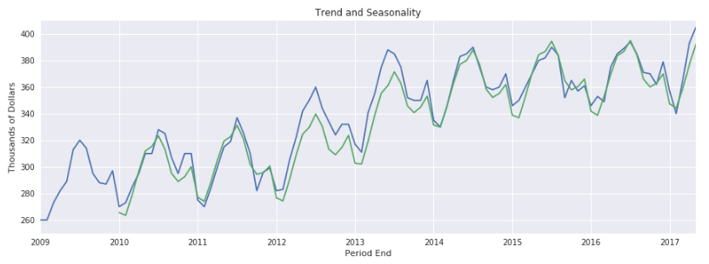
Decomposition Baseline
Trend and Seasonality = Trend + Seasonality
Use Trend and Seasonality to predict Median Sale Price (3 months ahead)
Notes:
Explanation:
Reason why you can only use trend and seasonality, not the leftover
By taking just two of the three components - trend and seasonality, you get a much better prediction than the naive baseline without a lot of work.
As you can see seasonality and trend provide a much better prediction than the naive baseline.
Two things to consider:
Do all the cities share the same seasonality?
And though its looks like a pretty good prediction, we know that the perfect prediction includes the leftover as well. This begs the question, is there anyway to predict the it? Hold tight, we’ll answer that in a second.
I must note that I did not correctly limit the trend component to 9 months when projecting to 3 months ahead and therefore inadvertently allowed the model to use ‘future trend’ data to be averaged into 12 month moving average when predicting 3 months ahead. I don’t believe this would alter the predictions a substantial amount but it is something to note.

Slide 9
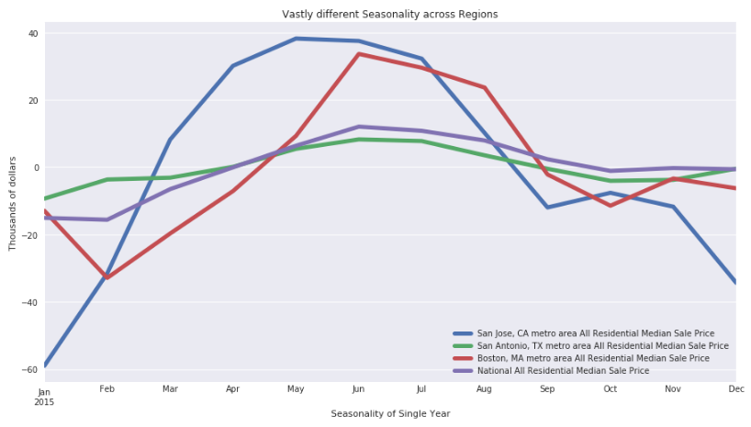
Seasonality Across Cities
High Season
San Jose (+40)
April - July
Boston (+30)
Jun - Aug
Low Season
San Jose (-60)
Jan
Boston (-30)
Feb
Steady Seasons
National
San Antonio
Notes:
Explanation:
It turns out seasonality is very different across cities
Anyone who is in the real estate business would be able to tell you seasonality is not consistent across all cities. The driving factors including: wanting to move during warm weather, moving while kids are out of school, and probably a posiive feedback loop as well
But putting the seasonal components side by side shows the drastic differences between San Jose and Boston.
Boston: ‘northern seasonality’ with a short high season during the summer
San Jose ‘southern seasonality’ with a longer spring into summer high season.
The national trend is also displayed to show how different it is from both the boston and san jose trends, though similar to san antonio. This is why it is a poor decision to always time your purchase on national information.
Just an interesting aside, I found that the coldest months in each of these cities coincide with the low seasons in their seasonality.

Slide 10
Predicting the Leftover
Baselines are univariate models
Use only previous values of Median Sale Price to predict
Is any of this signal explainable?
Reframe the problem as a regression problem, with the leftover as the target
Use the other features to predict it
Notes:
Explanation:
Up until the point, these were all univariate models. I.E. models that relied solely on the Median Sale Price itself.
You can imagine that we can probably get alot of other information out of these unused features
But before we get there, lets take a look at some of the features to see how they relate.

Slide 11
The Other Features
Sale Pricing
Median List Price
Median List Price per Sqft
Median Sale Price
Median Sale Price per Sqft
Sale Metrics
Price Drops (%)
Sold Above List (%)
Avg Sale to List (%)
Inventory Metrics
Inventory (1000s of)
New Listings (# of)
Homes Sold (# of)
Months of Supply (months)
Median DOM (Days on Market)
Which of these will be the best predictors of the Leftover?
Notes:
Explanation:
Lets take a quick look at a few of these variables to give us a better idea of how they may affect one another. Then we can begin predicting the leftover component.
They fall into roughly 3 categories:
Sale Pricing
Sale Metrics
Inventory Metrics

Slide 12
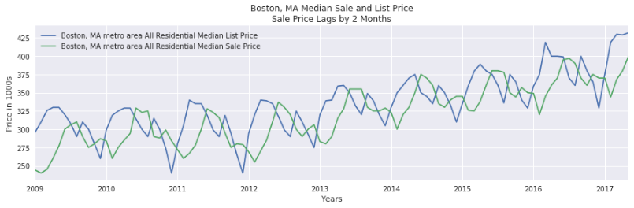
Median List and Sale Price
Notes:
First, take a look at the median list price and the median sale price.
The Median List Price leads the Median Sale Price by ~2-3 months which confirms our original hypothesis that the sale cycle is ~3 months

Slide 13
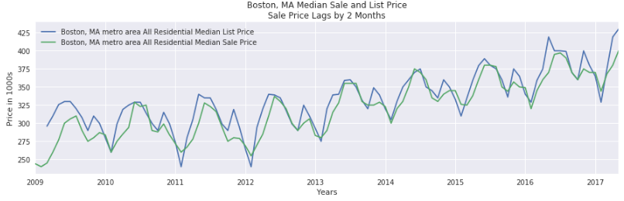
Median List Price Lagged 2 Months
Notes:
When lagging the median list price, it lines up nicely with the median sale price.
Expect this will be a good indicator

Slide 14
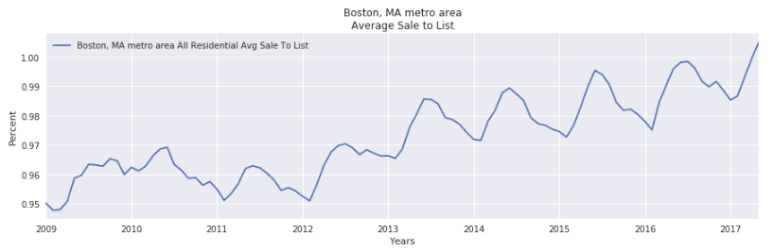
Average Sale to List
Early 2017, first time in 8.5 years, homes are selling more than they list!
Housing market is still strong in Boston
Notes:
Since we think the list price will be helpful in predicting, lets take a look at the ratio between the two: Average Sale to List Price.
It has steadily increased as the housing market has strengthened. The big turning point in the market was in 2012, which shows the deepest lows on the chart.
Perhaps it will show some
Also, in the early 2017 season, for the first time in 8.5 years, on average homes are selling more than they list! I’d say thats as good enough indicator as any that demand in the housing market is still strong.

Slide 15
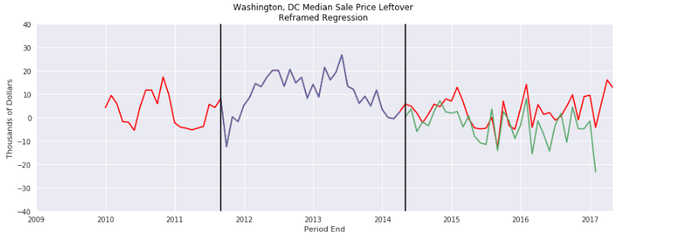
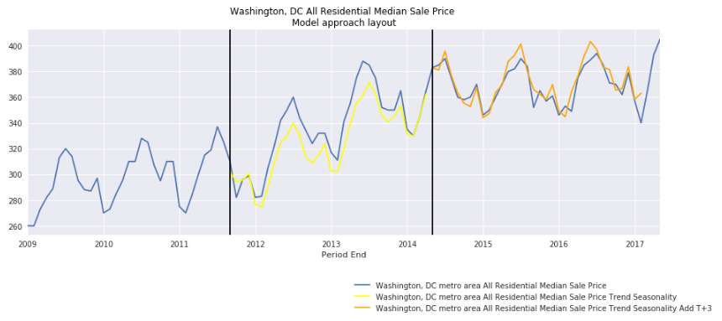
Regression Problem
Single model across all train cities
Split the timeframe into 3 parts:
Middle part to Train
Last part to Test predict Leftover vs target Leftover
Ultimately, add the predicted leftover back to our original decomposition model
Trend Seasonality and Predicted Leftover = Trend and Seasonality + Leftover
Notes:
Explanation:
This is important, but probably getting too far into the weeds for this talk, so I’ll keep it brief.
I basically took the leftover signal, broke it into 3 parts, then trained a model on the middle part to predict the values in the last part.
I did this for all cities.
Training for all cities is key because it allows us to see if there are features across all markets that explain the Leftover.

Slide 16
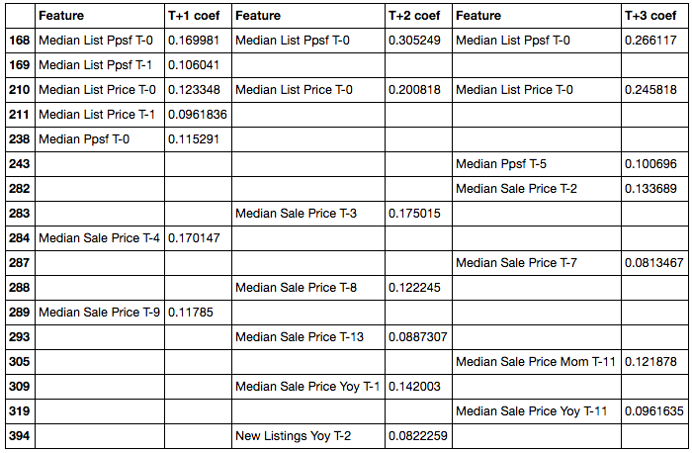
Top variables for predicting Leftover
1 Month Ahead
2 Months Ahead
3 Months Ahead
What variables does the model use to predict leftover?
Examine 4 variables:
Leading 3mo Median List Price per Sqft
Leading 3mo Median List Price
Leading 5mo Median Sale Price
Leading 10mo Median Sale Price
Notes:
Here were just taking a look at what the model uses to predict the leftover
Unsurprisingly, Median List Price and Median List Price per square feet.
This means that if you're planning on buying a house in july, you should examine april’s list prices to determine the magnitude the sale price will be above the decomposition baseline prediction.
The other two, the trailing 5 and 10 month Median sale price are more interesting
My hypothesis is that the research and sale cycle combined are ~5 months, and that buyers getting ready to purchase homes initially eye the market 5 months in advance of their purchase, and therefore expect to pay whatever they see at the beginning of their hunt.
Again, this means that if buying in July, you should examine february and the previous septembers sale prices. These will help predict the additional magnitude over the decompositional baseline prediction.
I’ve researched online and can’t find anything mentioning this phenomenon, so I reached to somebody I met at the meet and hire event to see it they can understand it. I’m still waiting for a response back.
So now that we have a model thats predicting the leftover, if we add it back into the original decomposition baseline, do we improve our score?

Slide 17
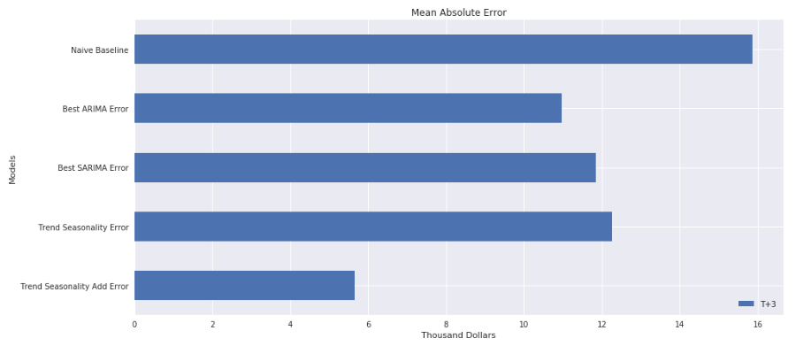

Evaluating the Model Predicting 3 Months Ahead
Our best model is $10.2k more accurate than the naive baseline.
Predicting the Leftover equates to a $6.4k more accurate prediction over the Trend and Seasonality alone
$6.4k
$10.2k
Notes:
The answer is yes! The bottom bar shows the error of our decomposition baseline with the predicted leftover, and the one above it shows the decomposition baseline itself.
You may be wondering what the ARIMA and SARIMA models are since I didn’t even mention them but needless to say, they are standard approaches for timeseries forecasting.
These are all evaluated with the metric of mean absolute error. This basically takes all the values our prediction, adds them together and takes the average.
This result clearly proves there is still value in the Leftover which is unaccounted for by Trend and Seasonality.

Slide 18

To sum it up
Take advantage of the seasonal trends of your city
Easiest method to make the most money
In addition:
Leading 3mo List Price & Ppsf,
Leading 5mo & 10mo Median Sale Price
Now I have two reasons to sell in the Summer
The gaps between my floorboards don’t show
Better price
Come ask me questions, afterward!
Many more slides!
Notes:
I’d love to explain the whole train test method which I didn’t have time to go into as well

Slide 19
Top variables for predicting Leftover
Three Models:
1 month ahead
2 months ahead
3 months ahead
These 4 variables are the most consistent across the models
Trailing 3mo MLPpsf
Trailing 3mo MLP
Trailing 5mo MSP
Trailing 10mo MSP
1 Month Ahead
2 Months Ahead
3 Months Ahead
Notes:
This holds true for models predicting the leftover 1, and 2 month ahead as well. Which is really cool.
These 4 variables consistently predict the leftover. Theres clearly a strong pattern in the 5 and 10 month trailing sales prices.
So now that we have a model thats predicting the leftover, if we add it back into the original decomposition baseline, do we improve our score?

Slide 20
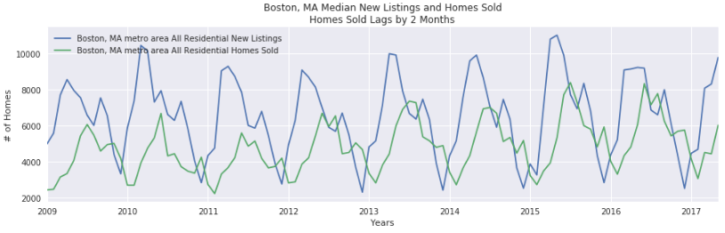
Homes Listed and Sold
Notes:
Finally, take a look at Homes Listed and Homes Sold.
What immediately jumped out at me was the number of homes listed is always higher than the number of homes sold - while the inventory stays steady.
I’m not entirely clear on this, but I would expect there are a lot of homes delisted that never get sold.
It looks like theres a 2 month lag between listed homes and sold homes. If we took the difference of these two, would there be a story to tell?

Slide 21
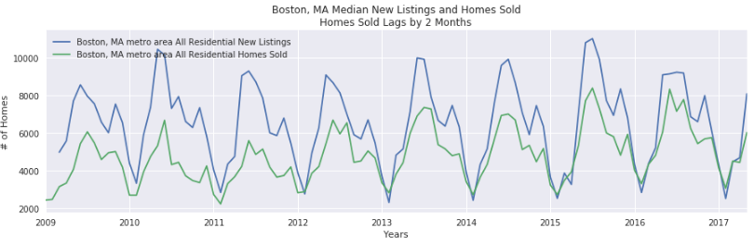
2 Month Lagged Homes Listed and Sold
Notes:
First lag homes listed by 2 months

Slide 22
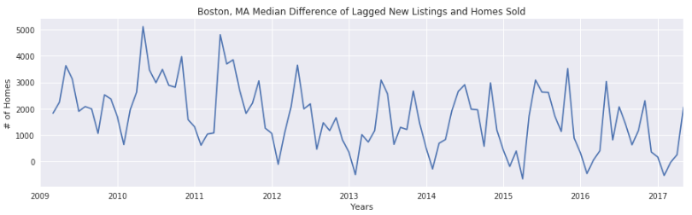
Houses Listed but not Sold
Notes:
Then subtract the two, and you get this result which shows a clear reduction in the number of homes delisted/unaccounted for.
If our hypothesis is correct, this would mean less homes are being delisted.
It looks pretty clear that there are a lot less homes delisted in 2012 than previous years, again 2012 was the market bottoming.
All these variablesl give you a good idea of what type of features are included in the dataset. Now using these, lets go back to the goal of predicting the leftover from our decomposition.

Slide 23
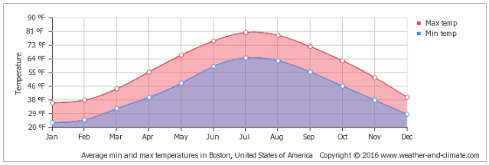
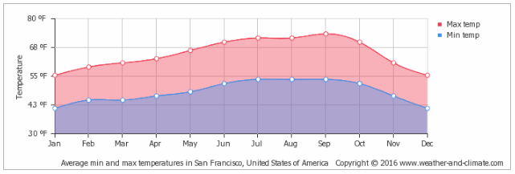
Interesting Aside
Coldest months are the low season
Haven’t checked other cities
Boston Weather
Jun-Aug ~70s
Jan-Feb ~20/30s
San Jose Weather
Apr-Jul ~60s
Dec-Jan ~40/50s
Notes:
Just an interesting aside, I found that the coldest months in each of these cities coincide with the low seasons in their seasonality.
I didn’t have a chance to truely incorporate any historic weather into the data, but I’d expect heavy winter seasons to play a role.

Slide 24
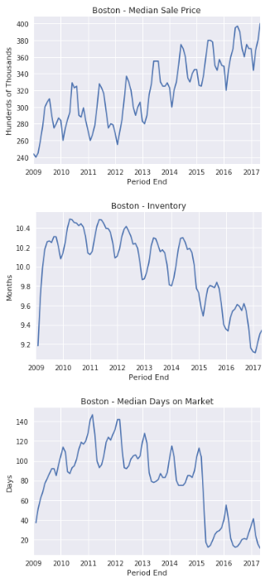
Cleaning, Exploring, Transforming
I concated the TSVs from Redfin and manipulated them from
Long: (18670,41) to Wide: (101,6825) format
Resulting in each city being a (101,175) sized chunk side by side
Dropped all property types except ‘All Residential’
Due to the lack of overlap in all markets
Null values were imputed with the mean of the column
Luckily for last 6 yrs only Mom and Yoy values needed this
Lagged data for 2nd stage models
Shifted the Median Sale Price up 1, 2, 3 months
Shifted all others down 1-13 months

Slide 25
Producing a one-fits-all model
Approach:
Split cities randomly into 18 Train and 9 Test cities
Test Cities:
First 32mo
Train 1st stage models: ARIMA, SARIMA, Decomp
Last 36mo
Predict MSP
Add/Subtract the leftover from pretrained 2nd stage models
Train Cities: split the timeframe into 3 parts:
First 32mo
Train 1st stage models: ARIMA, SARIMA, Decomp
Middle 32mo
Predict MSP with 1st stage models and record the leftover
Train a 2nd stage models to predict the leftover
Last 36mo
Predict MSP with 1st stage models
Add/Subtract the 2nd stage leftover prediction

Slide 26
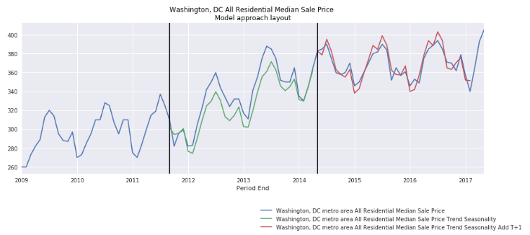
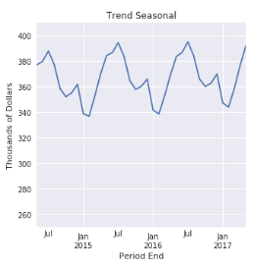
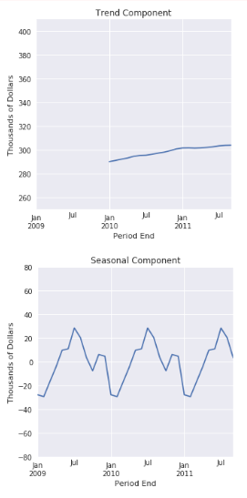
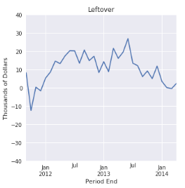
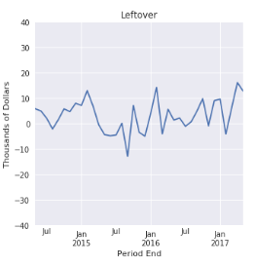
Ex. Trend and Seasonality Add Model
first 32mo
last 36mo
middle 32mo
1st stage model prediction
1st stage model trained
2nd stage model trained
Trained to predict this
Tries to predict this
Notes:
Make it less cluttered or animate it
Show only what people want to look at
Don’t use the 3 slices of time
Keep as technical slide
Keep simple
Explain what the first model is doing
How we analyze the residuals
And if there is an underlying trend that helps predict it
Sizing of the graphs, clean it up

Slide 27
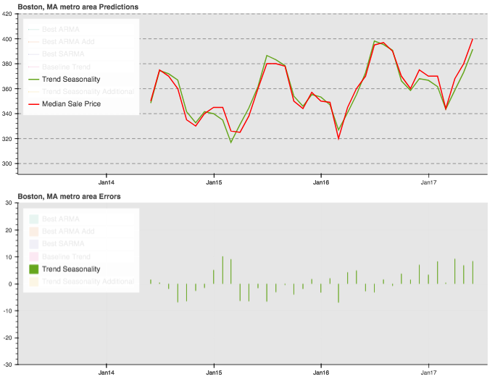
Trend Seasonality
Additive Decomposition
Trend - moving average
Seasonal - component

Slide 28
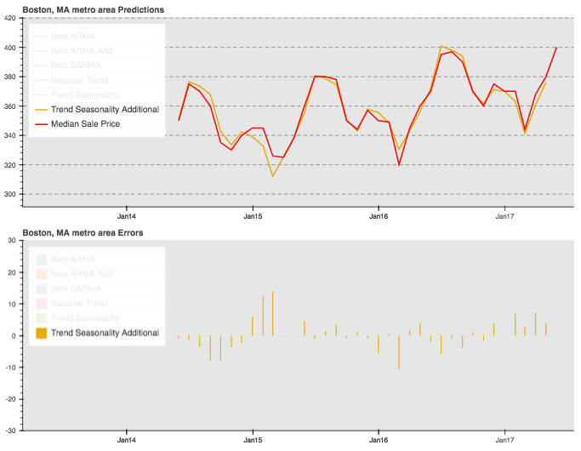
Trend Seasonality Add
Additive Decomposition
Trend - moving average
Seasonal - component
Additional 2nd stage prediction

Slide 29
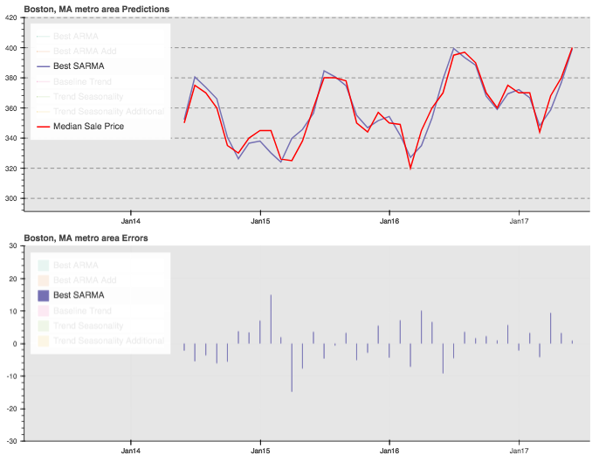
Best SARIMA
Seasonal Autoregressive Integrated Moving Average (1,1,0) (1,1,0,12)
Gridsearched across all Train cities
(1,1,0) (1,1,0,12) had the minimum error

Slide 30
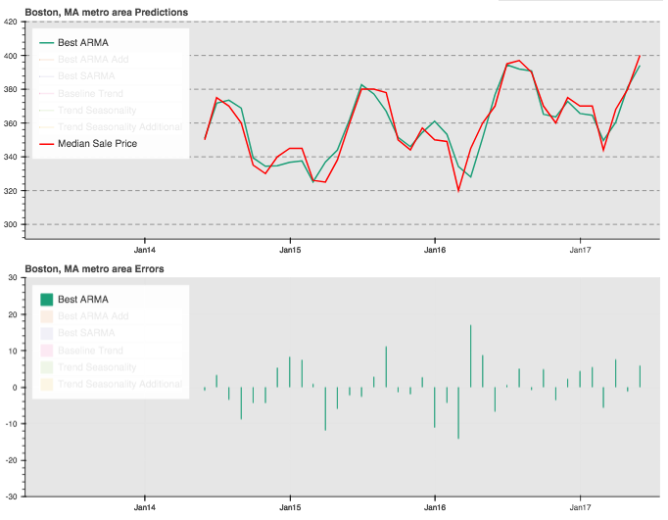
Best ARIMA
Autoregressive Integrated Moving Average (15,2,0)
Gridsearched across all Train cities
(15,2,0) had the minimum error

Slide 31
Evaluating the models
Mean Absolute Error
Similar to RMSE but doesn’t penalize larger errors any different than smaller errors
Easily interpretable
Timeseries Naive Baseline and Trend Baseline
Naive Baseline - uses the current value to predict future value
Trend Baseline - moving average over X days
Score each model for each Test city by taking MAE of prediction
Average the MAE across all Test cities
The model with the minimum error across all Test cities is the best at generalizing
Interesting to note:
Most difficult cities to predict were San Jose and San Francisco

Slide 32
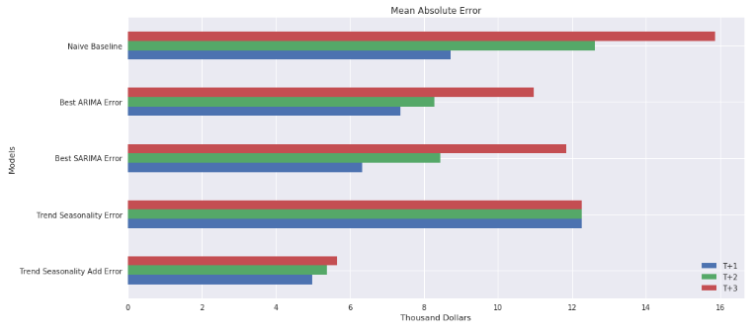
Evaluating the models
Trend Seasonality Add makes a $3.7k more accurate prediction at T+1. And a $10.2k more accurate prediction at T+3 over the naive baseline.
$10.2k
$7k
$3.7k

Slide 33
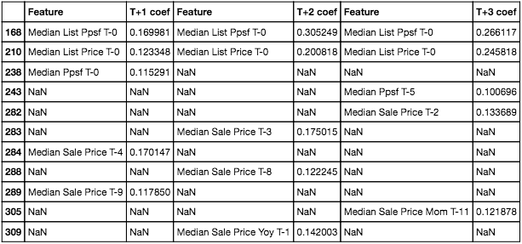
Top 5 coefs of ElasticNet for Trend Seasonality Add T+1, T+2, T+3
Median List Price/Ppsf T-0
Even though the time between the target and the T-0 increases, MLPpsf is consistently at the top
Median Sale Price T-4! (T-5?)
Originally thought it wasn’t consistent when looking at each set of coefs individually
MSP 5 months prior is an indicator across all T+1, T+2, T+3 models
Makes intuitive sense right?
Future MSPs are very much dependent on list prices in the past
MLP coef peaks with T+2 model, hinting that houses for the region take 2-3 months to sell
Notes:
Above trend and seasonality
This stuff accounts for 15k
Highlight the top 3 featues and bullet them and what they are
Concise explainations what each coef means in like 4ish words
This is over and above the 75k from seasonality
And above trend
I found another 15k in your pocket
Talk to somebody in realestate and ask about these coefs, do these make sense and why are these the case?
First 5-6mins for seasonality and the trend info
Next part explain the harder residual part
Mettric of concern index at the end

Slide 34
What can you save by upgrading your tech?
By using the new model you can make decisions that are $3.7k more accurate when entering and exiting from the market, allowing you to potentially realize $7k per transaction.
If you do 8-10 flips a year, which is an average volume for a small business, you could realize $56-70k of savings per year.
Expanding your business to take advantage of 3 month-out predictions, the company could save a whooping $140k-200k per year!

Slide 35
What else could make the tech/project better?
Supervised Learning Timeseries:
Trained an ElasticNet, Random Forest Regressor, and a Linear SVM Regressor with MSP alone as target, each produced very poor results
However, I read LSTM neural nets are very good at timeseries analysis
Add in Case-Shiller Index data
House by house value increase
I don’t believe this would have increased my current predictions, but I expect it would reduce my model’s bias during a market downturn
Notes:
Justify
Use terms actual vs predicted
Use T+3
Be careful of the T-0 stuff. Remove and use an example case to explain instead

